Slide 1
HTML colors

Slide 2
Agenda
HTML colors
Sample output
HTML colors implementation

Slide 3
HTML colors
With HTML colors we can color text, background of text, border of paragraph
We have 3 standards of to use colors in html.
1. RGB Range (0 to 255)
rgb(0, 0, 255)
2. HEX Range (00 to ff)
hex(00ff00) //green
3. HSL Range(0% to 100%)
hsl(100%, 0%, 0%)

Slide 4
HTML colors
Syntax
Text background color:
<h1 style="background-color: rgb(255,0,0);"> RGB Color </h1>
<h2 style="background-color: #00ff00;"> Hex Color </h2>
<h3 style="background-color: hsl(10, 20%, 50%);"> HSL Color </h3>
<h3 style="background-color: green;"> HSL Color </h3> // another way
Text Border and color:
<h5 style="border: 2px solid green;"> Header 5 </h5>
<h6 style="border: 2px dotted rgb(121,22, 222);"> Header 6 </h6>
3. Text Color:
<p style="color: darkorange;"> Hi Learner's </p>
<p style="color: darkblue;"> Welcome to Great Learning </p>

Slide 5
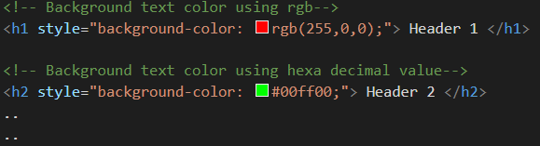
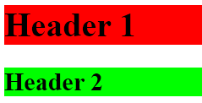
Sample output

Slide 6
HTML colors implementation
Let’s see HTML Colors Implementation.

Slide 7
Summary
We have seen different ways of using colors in HTML.
We seen different ways of using borders with different styles.
We have also seen how to color text in HTML.
DO NOT WRITE ANYTHING
HERE. LEAVE THIS SPACE FOR
WEBCAM

Slide 8
Thank You
Proprietary content. ©Great Learning. All Rights Reserved. Unauthorized use or distribution prohibited

